Slide 1
System Design
GeeksforGeeks
Instructor: Hrishikesh Kulkarni

Slide 2

Agenda
Introduction
Who are the target audience.
Expectations from the course
Expectations from the learners
Why and How
What a System Design interview is?
Design Fundamentals : Real Tools
Design Fundamentals: Actual Components
Design Fundamentals : Key Characteristics
Design Fundamentals : Fundamental Knowledge
Design Fundamentals Categories
How System Design Interview works
Expectations from an interviewee
Chaotic Approach and Systematic Approach
Recommended System Design framework
Requirement Analysis : Generic Questions
Requirement Analysis : Example (Design a IoT based system)
Data Modelling
High Level Design
System Interfaces
Back of Envelope estimations

Slide 3
About Me
Sr. Software Engineer at Linkedin
Prior experience:
Directi (platform engineer)
Observe.AI (SDE)
Stocko-meter (Co-founder)
Contact Info :
hrishikesh.kulkarni.official@gmail.com
Phone: 7020629637
Linkedin: linkedin.com/in/h-kulkarni

Slide 4
Target Audience
Working professionals looking to give interviews for senior position.
Working professionals looking to learn how to design a distributed system and add more value to their professional career.
Students (Optional)

Slide 5
Expectations from course
Will build strong foundation around the basic and advanced components of system design
Will help you for day-to-day life as well as interview cracking
Mix of theory and problem solving

Slide 6
Expectations from learners
Have implemented some application on production
Basic understanding of databases
Clarity on basic concepts of data structures and Algorithms (DSA)
Hashing
Tries
Array manipulation algorithms (Sliding window, 2 pointer ...)
Trees, BST

Slide 7
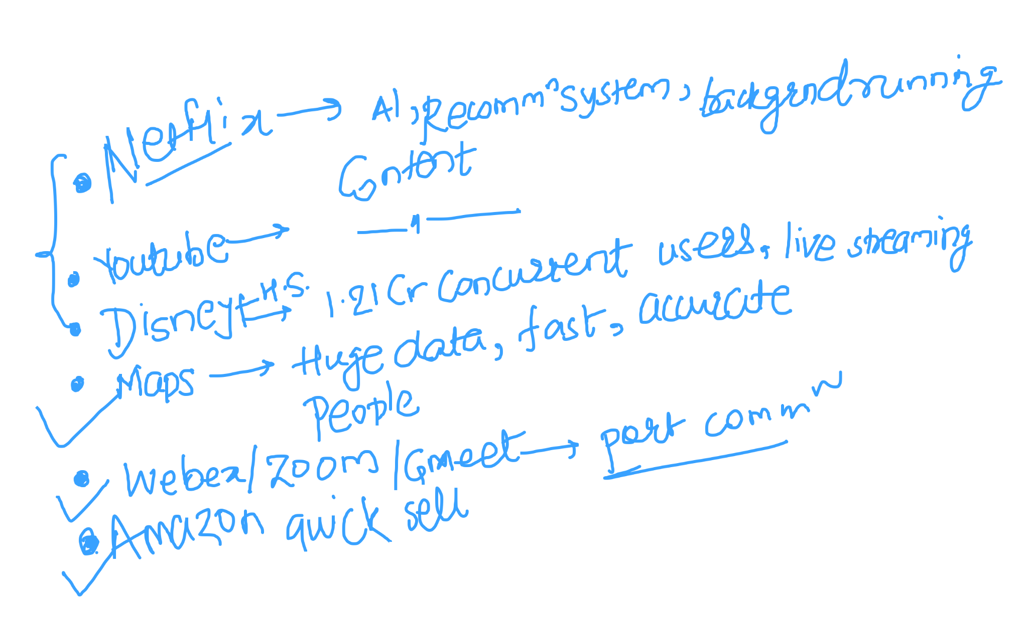
Which online system you admire the most?

Slide 8
What exactly is a System Design Interview?
Coding Interview
A software engineer ability to problem solving
System Design
Requires knowledge of how to build robust, functional and scalable systems as per requirements (business).
Design fundamentals help you achieve all the above

Slide 9
How System Design Interview works
Questions are intentionally very vague
Eg : Design Uber, Facebook etc
Take this question and convert it into 45 mins discussion
Never objectively correct or incorrect
Confidently justify your solution
Explain why you made certain choice
Why you preferred parts of your system one way and not the other
Defend or correct your design when the interviewer challenges it.

Slide 10
Design Fundamentals Categories
Fundamental Knowledge
Key Characteristics of your system
Actual components of your system
Real tools used as components (not necessary to know)

Slide 11
Fundamental Knowledge
Client Server model
Network Protocols

Slide 12





Key characteristics of your system
Availability
Latency
Throughput
Redundancy
Consistency

Slide 13
Actual Components of your System
Load Balancers
Proxies
Cache
Rate Limiting
Leader Election

Slide 14
Real tools used as Components
Zookeeper
Etcd
Nginix
Redis
Amazon S3
Google Cloud Storage
Microsoft Azure

Slide 15
System design concepts/terminologies
Scalability vs Performance
Latency vs Throughput
CAP theorem
Consistency patterns
Availability patterns
DNS
CDN
Load balancers
Proxy servers
Forward proxy
Reverse proxy
Database
RDBMS
No-SQL
Caching mechanisms and strategies
TCP vs UDP
Consistent hashing

Slide 16
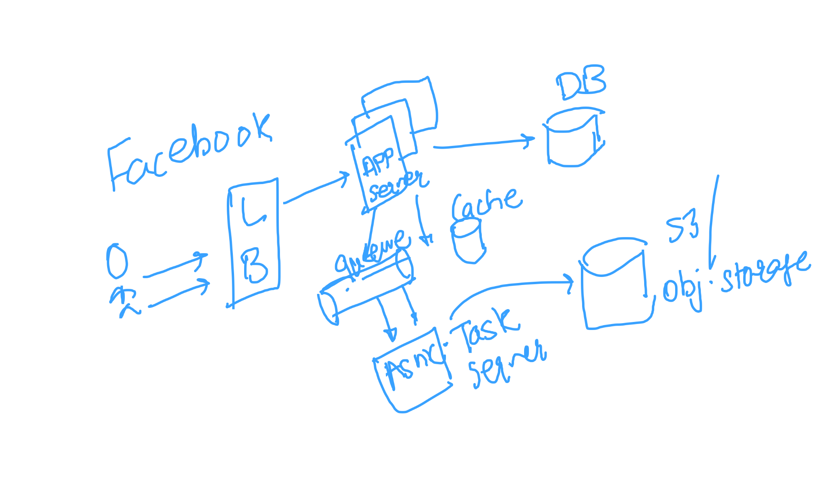
System design concepts/terminologies

Slide 17
Scalability and Performance:
Scalable service => If it results in increased performance in a manner proportional to no. of resources added.
Here increased performance means handling more units of work.
Remember:
Performance issue in system means: system is slow for single user
Scalability issue in system means: system is fast for single user but slow for heavy traffic

Slide 18
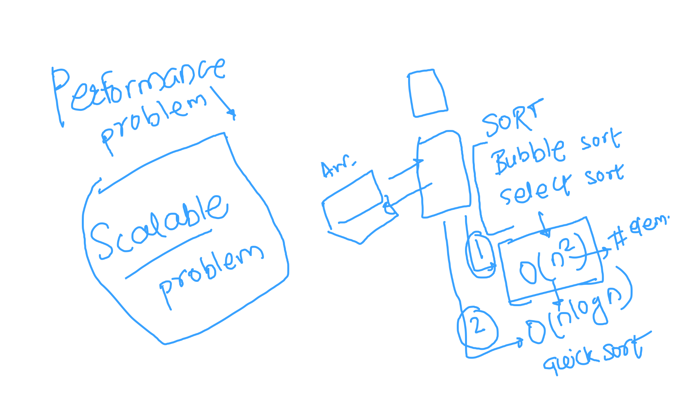
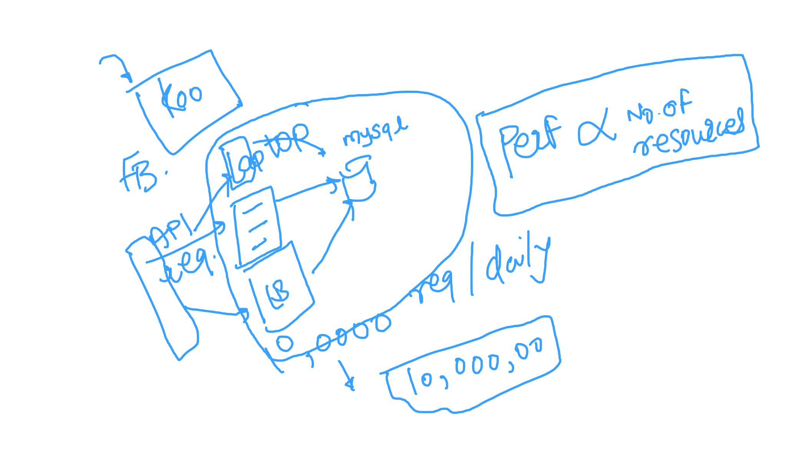
Scalability and Performance:

Slide 19
Latency and Throughput:
Latency => Time taken to perform some action or produce some result
Example
Throughput => Number of such actions/results per unit time
Remember:
One should aim for maximum throughput with low/accepted latency.

Slide 20
Consistency, Availability, Partition tolerance
Consistency:
Every read receives the most recent write
Availability:
Every request receives response, without guarantee that it contains the most recent version of information
Partition tolerance:
System continuous to work despite arbitrary network failures.
Remember: Networks are not reliable. So for any large scale system you need to support partition tolerance.

Slide 21
CAP Theorem
It states out of Consistency, Availability and Partition tolerance only 2 can be concurrently utilized. It means one must be sacrificed.
Since PT needs to be supported, we must trade-off between Consistency and Availability.
CP systems:
Useful when data needs to be accurate for every request.
Example: transactions
AP systems:
Returns most recent data available on node, which might NOT be most recent data.
Example: Youtube views

Slide 22
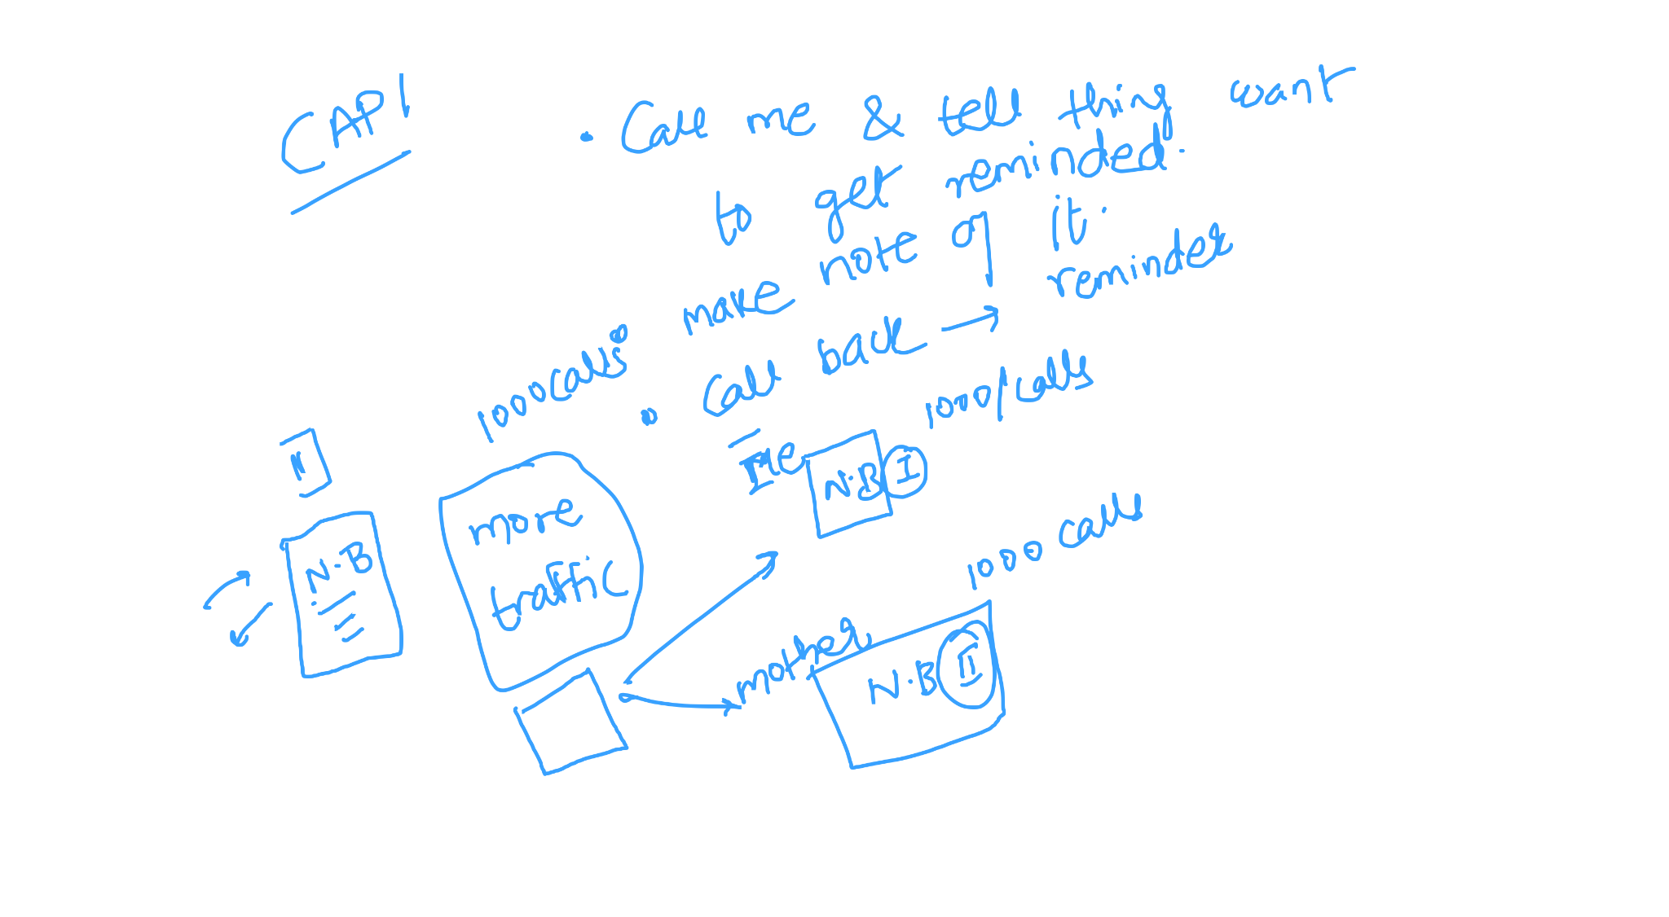
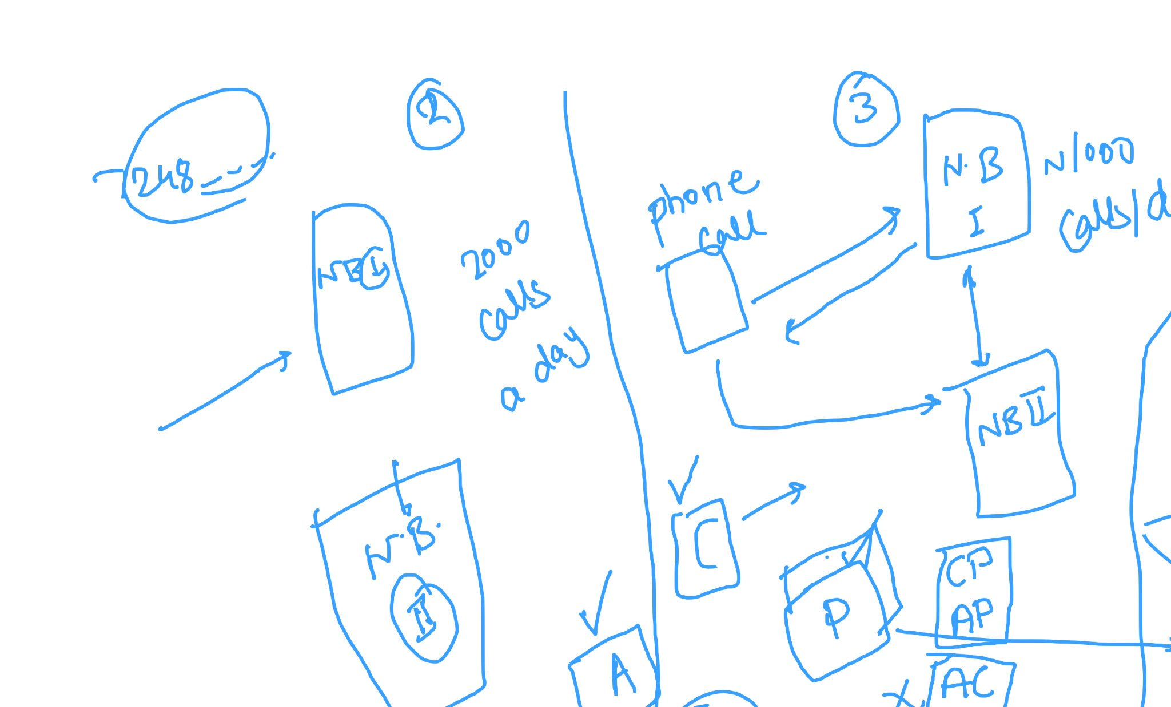
CAP Theorem

Slide 23
Types of consistency (consistency patterns):
Weak consistency:
After a write, read may or may not see it.
Works well in real time use cases such as VoIP, video chat, real-time multiplayer games. Memchached follows this pattern.
Eventual consistency:
Specific form of weak consistency. After a write, reads will eventually see it (Typically in range of milliseconds to seconds)
Data is replicated asynchronously. This pattern is used in highly available systems.
Ex. DNS, Email
Strong consistency:
After write, all reads will see most recent value.
Useful in systems where number of resources are limited and their status/value matters for business. RDBMS uses this pattern.
Notes:
Good reference to look for: https://snarfed.org/transactions_across_datacenters_io.html
https://github.com/henryr/cap-faq

Slide 24
Availability patterns
Master slave (active-passive) architecture:
Heartbeats are sent from active (master) node after some intervals. If it fails to send heartbeat, passive (stand-by) server takes over.
Very common in industry
Master master (active-active) architecture:
Both nodes are handling traffic. If one of the node fails, all traffic will be redirected to single node.
Logic needs to be handled at load-balancer level.

Slide 25
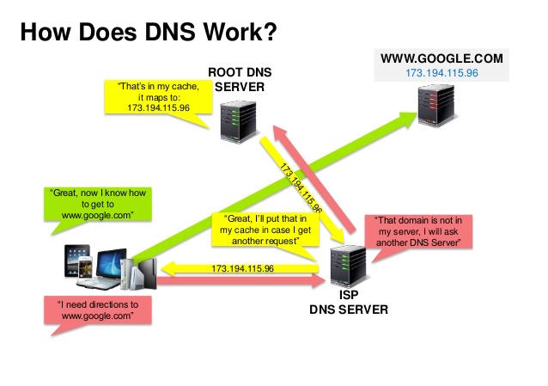
Domain Name Service (DNS):
Translates domain name to an IP address. Example: google.com to 1.0.0.0/24
Tree like structure. Root DNS actually maintains record of mapping.
Key DNS records:
Name server: Specifies DNS servers for domain/subdomain
Mail exchange (servers): Specifies mail servers for accepting msgs.
Alias record (Name to IP address)
Canonical name
Meta data such as: TTL, refresh interval
Notes:
DNS architecture interesting read

Slide 26
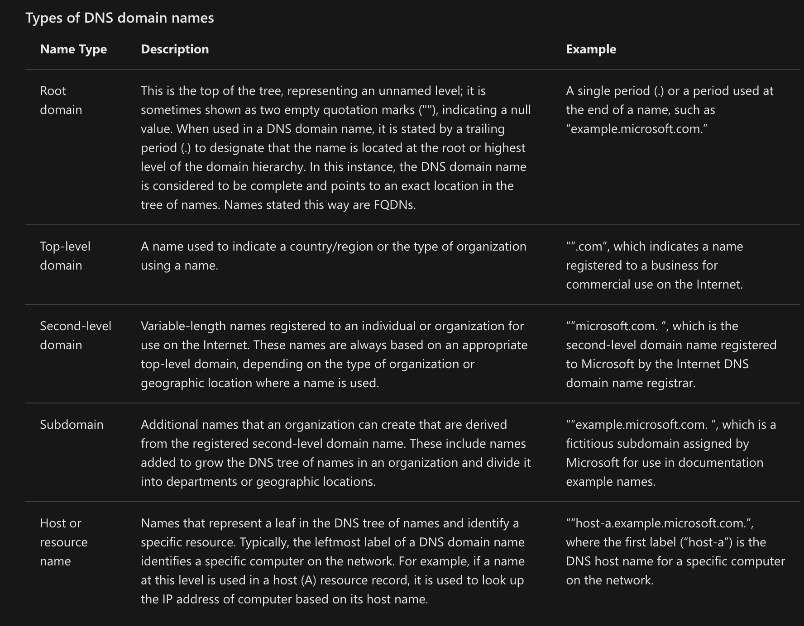
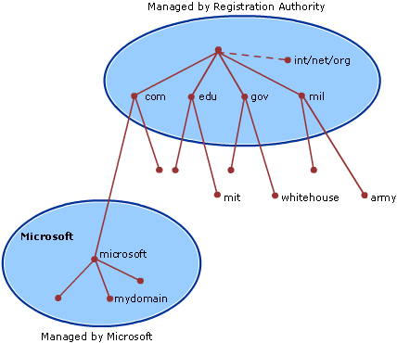
Domain Name Service (DNS):
Notes:
DNS architecture interesting read, BGP
https://blog.cloudflare.com/october-2021-facebook-outage/

Slide 27
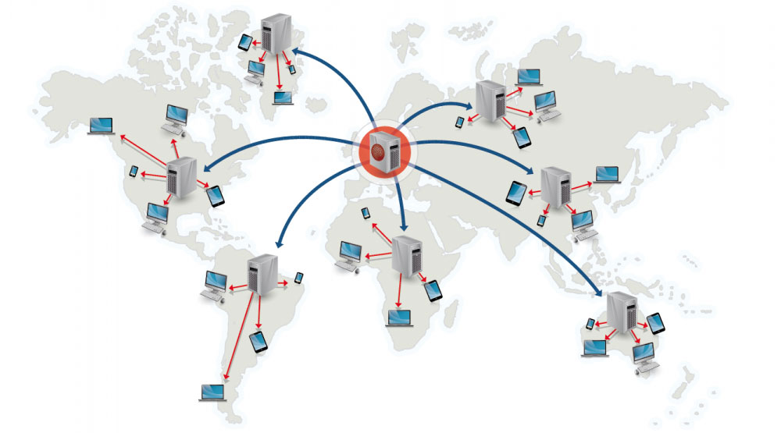
Content Delivery Network (CDN)
Serves static content to closest users
Static content is usually served
HTML, CSS, JS
Images
Videos, transcripts
Website's DNS resolution will tell clients which server to look for
2 categories:
Push CDN
Pull CDN
Notes:
https://figshare.com/articles/journal_contribution/Globally_distributed_content_delivery/6605972

Slide 28
CDN categories
Push CDN:
CDN receives changes whenever changes occur on the server
Website server takes responsibility of providing content
Whenever uploading is in progress, first erase CDN entry from DNS, upload content to CDN, add entry of CDN to DNS
Sites that are small or less frequently changes or static in nature works well with Push CDN
Pull CDN:
Grab content from original server whenever first user requests comes in system.
TTL is associated with each record to refresh stale data
Sites with heavy traffic uses pull CDN

Slide 29
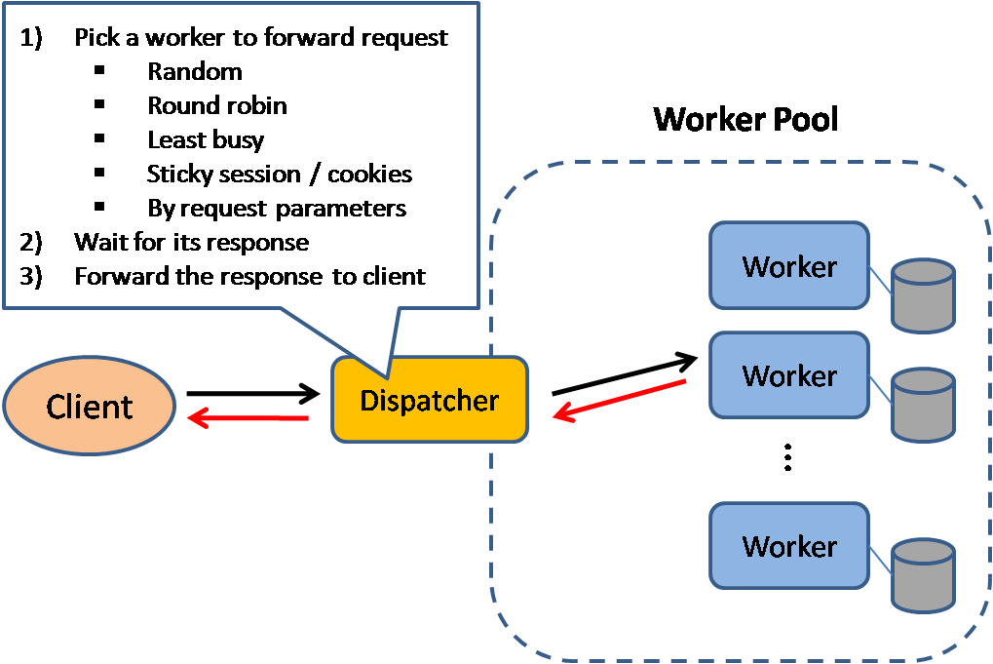
Load balancer
Distributes incoming requests to resources. After getting response, it returns the same to client
Useful for:
Prevent incoming requests going to unhealthy resource
Preventing overloading of resources
Avoiding single point of failure

Slide 30
Load balancer (contd.)
Traffic routing techniques:
Round robin
Randomized
Least connection based
Least resource based
Sticky session (hash based)
Million $$$ question:
To avoid single point of failure, we introduce multiple servers and handle traffic using load balancer. Now isn't load balancer single point of failure?
Notes:
DNS architecture interesting read

Slide 31
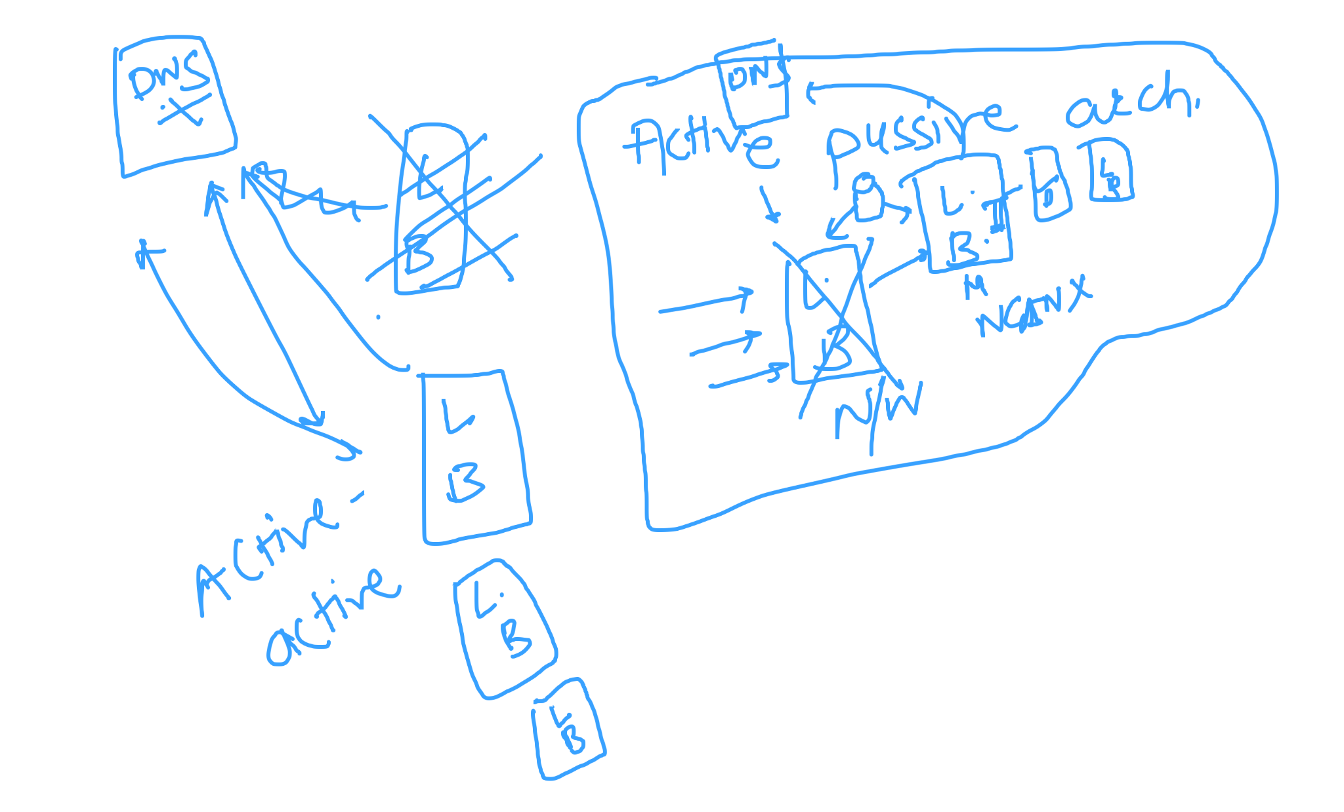
Load balancer (contd.)
Million $$$ question:
To avoid single point of failure, we introduce multiple servers and handle traffic using load balancer. Now isn't load balancer single point of failure?
Notes:
DNS architecture interesting read

Slide 32
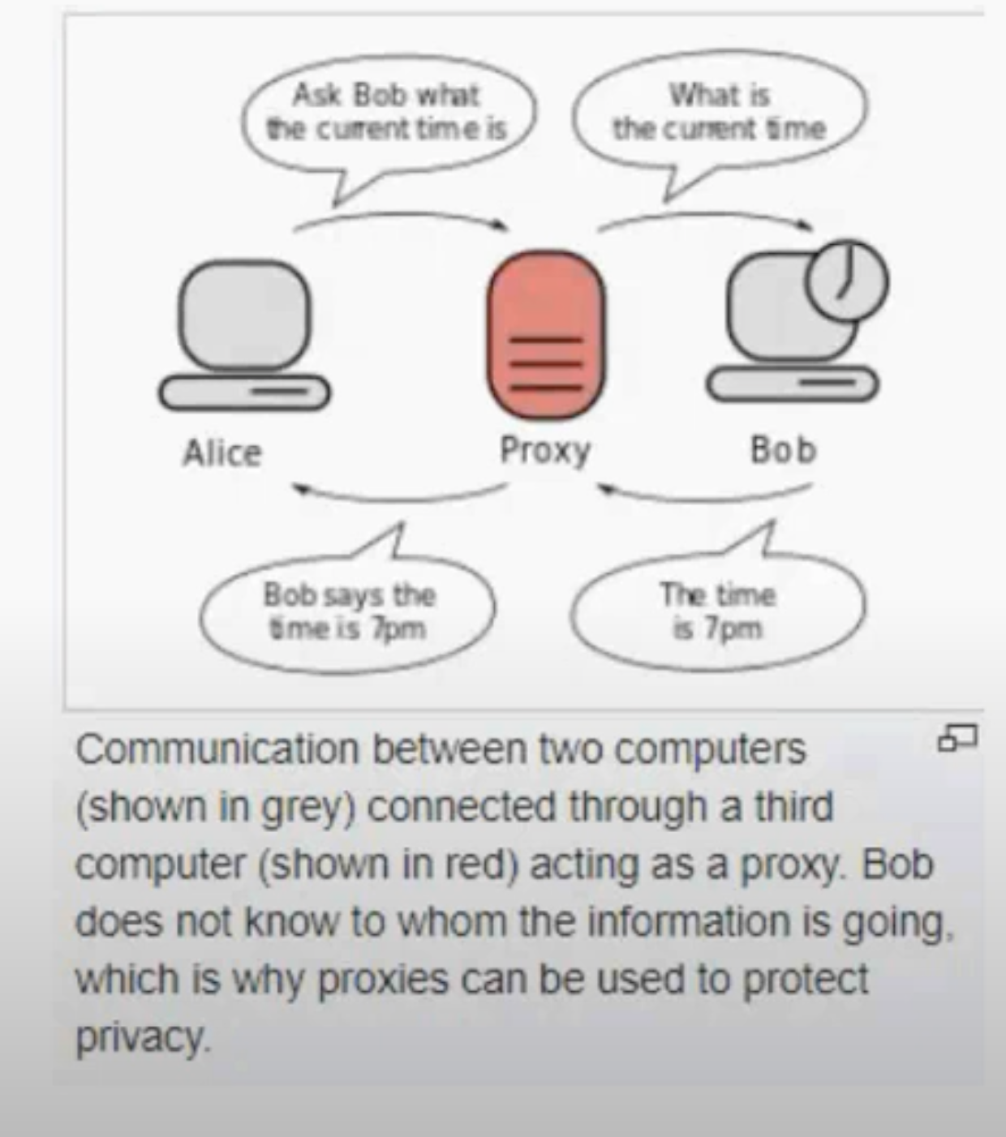
Proxy servers
Can reside on client's local server or anywhere between client and remote server
Client connects to proxy server, requests for specific resource. Proxy forwards it to destination and returns info back to client
Encapsulates distributed service
Types of proxy:
Forward (Open) proxy
Reverse proxy

Slide 33
Forward proxy
Can forward any request from internet, fetch the data and return back to original user/client
Mostly used for anonymity purpose as it does not show IP of original server

Slide 34
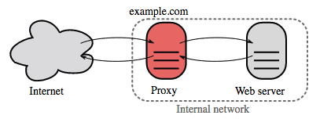
Reverse proxy
Acts like a web server that centralizes internal services and provide unified interfaces to end users
All requests to facebook.com hits reverse proxy, request type is identified, forwarded to appropriate internal servers and finally response is returned to original user by reverse proxy
Benefits:
Additional security
scalability solution
caching mechanism implementation for static content
Can implement rate limiter and provide DDoS attacks solution
Can be useful to do A/B testing

Slide 35
Find difference(s) between
reverse proxy and load balancer!

Slide 36
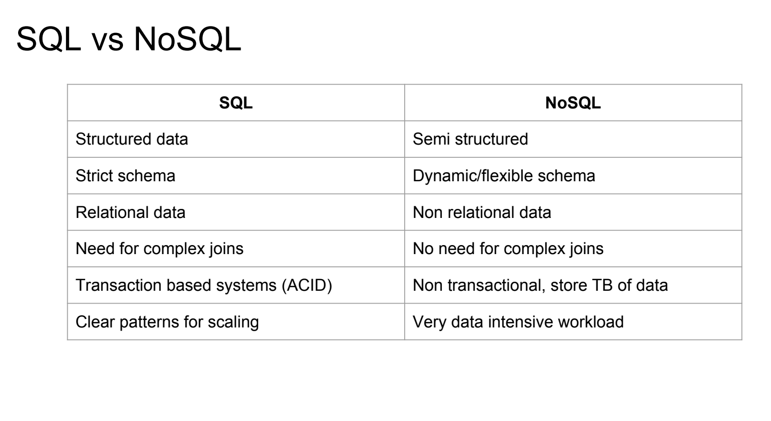
Databases
Used to store data that will be queried to gain insights / give information if requested
2 major categories:
SQL based (RDBMS) -> Atomic, Consistent, Isolation, Durable
No-SQL based -> Basically Available, Soft state, Eventually consistent

Slide 37
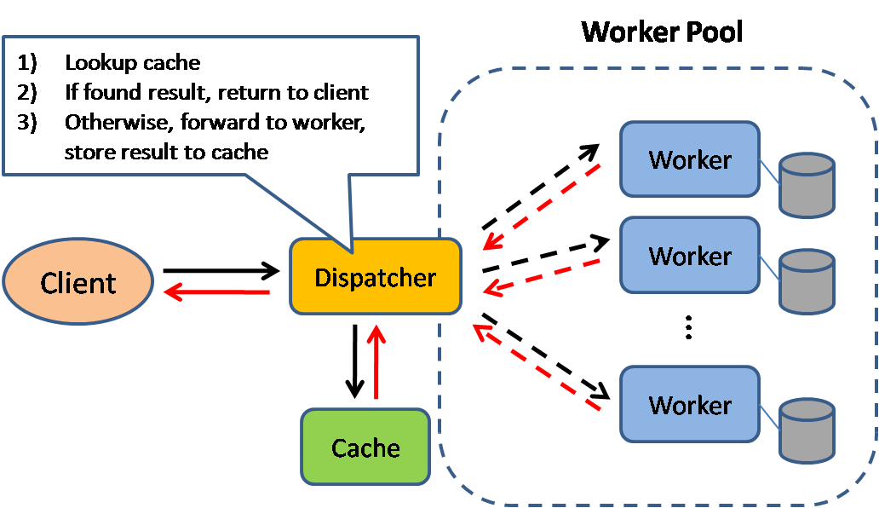
What is cache?
Keeping frequently accessed data at a place where retrieval is extremely fast
Caching can improve page load time, reduce API response time, reduce load on server etc.

Slide 38
Where can we put cache?
Client caching (OS, browser based)
CDN caching
Reverse proxy level caching
Database caching
Application caching
In memory cache
Cache at DB query level
Cache at API level

Slide 39
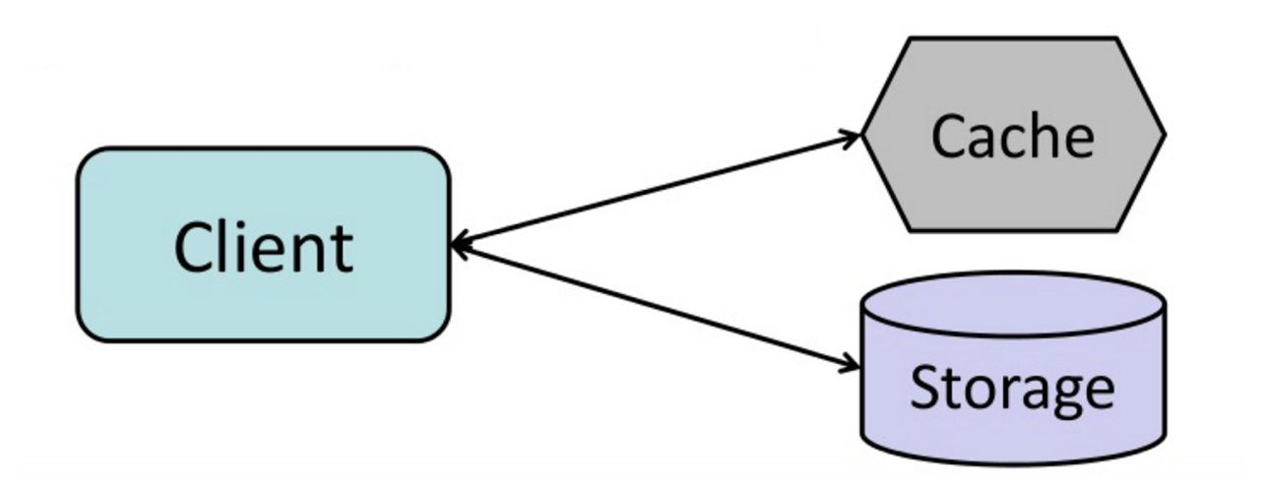
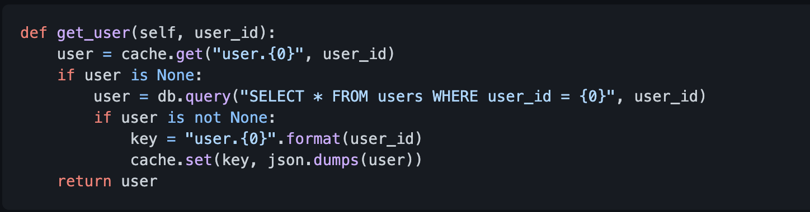
Caching strategy: Cache Aside
Cache does not interact with DB directly
Process:
Look for an entry in cache, causing cache miss
Load entry from DB/Other resources
Add entry to cache
Return entry (Memcache)
Application needs extra logic to write to cache
Disadvantages:
Cache miss will result in 3 trips (delay)
Data can be stale if updated in DB (Use TTL)
If node fails, new node will take over with empty storage => lot of cache miss

Slide 40
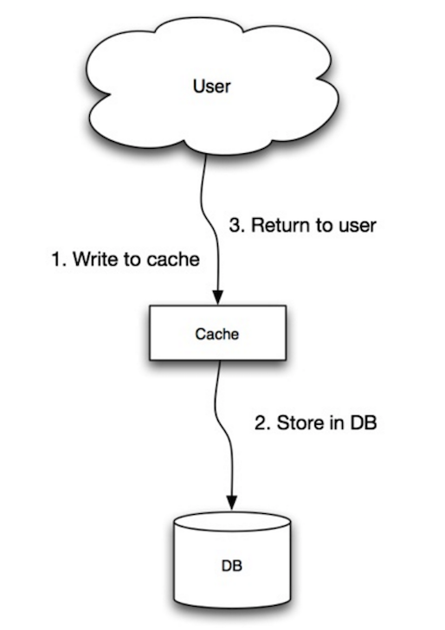
Caching strategy: Write-through
Application uses cache as main data storage. Cache is responsible to read and write to DB
Overall slow operations, but subsequent reads of recent data faster. (User behaviour)
Also data in cache is never stale
Problems:
Slow writes
Most of data written in cache may never be read - causing wastage of cache memory

Slide 41
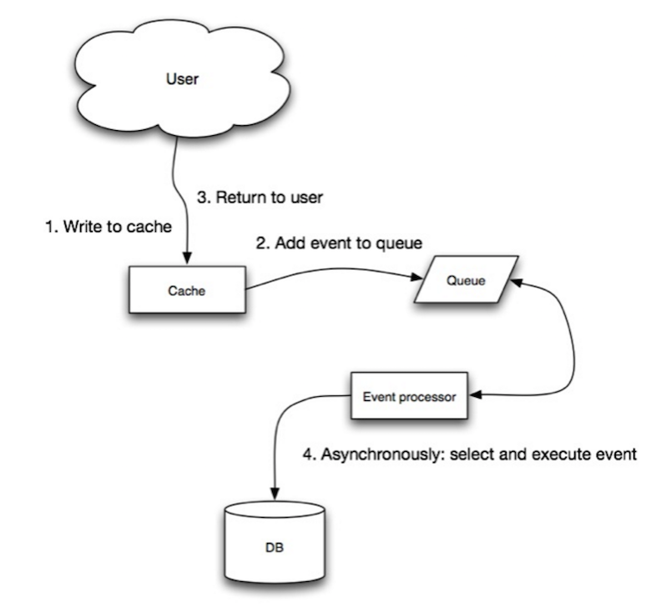
Caching strategy: Write-behind (Write-back)
Process
Problems:
Could cause data loss if node goes down before adding entry in queue
Implementation heavy
Find more caching strategies!
Notes:
https://docs.oracle.com/cd/E15357_01/coh.360/e15723/cache_rtwtwbra.htm#COHDG197

Slide 42
Cache eviction strategies
First In First Out
Least Recently Used
Most Recently Used
Random Replacement
Least Frequently Used
Adaptive Replacement Cache (LRU + LFU)
Notes:
https://leetcode.com/problems/lru-cache/
https://leetcode.com/problems/lfu-cache/

Slide 43
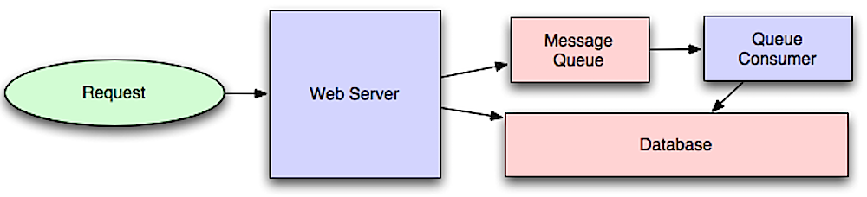
Asynchronism
Async workflow help reduces request times for expensive operations that would otherwise take longer time if performed in-line
Message-queue is mean to achieve this

Slide 44
Use cases:
To communicate with external service which is flaky
Report generation/analysis/response will be sent to your email address
Video encoding: If you're building youtube, you would not want people to wait till entire video is encoded to different versions
Email sending
Microservice communication
Any service which does not required real-time in-sync communication, add message queue!

Slide 45
Message queue:
Message queue receives, holds and delivers messages. If operation is too slow to perform inline to perform inline, following work-flow is used:
Application pushes a job to queue.
Worker/client-service picks up job from queue (using long polling) and processes message
User is not blocked and job is processes in background. Some task will be done in sync to provide user satisfaction.
Examples: Rabbit-MQ, AWS SQS
Dead letter queue
Message-queue vs pub-sub architecture
Notes:
https://www.baeldung.com/pub-sub-vs-message-queues
https://www.educba.com/rabbitmq-architecture/
https://www.youtube.com/watch?v=sRiLP5Pkqj0&ab_channel=RabbitMQSummit
Todo: Kafka paper

Slide 46
Task queue:
Task queue receives task and associated data, runs them and then delivers result.
They support scheduling and running compute intensive tasks in background.
Example: Apache airflow, Celery
Notes:
https://docs.celeryproject.org/en/stable/

Slide 47
Elastic-Search:
Distributed, open source, search and analytics service built on top of Apache Lucene
Easy to scale
Allows to store, search, analyze huge amount of data quickly and near real time
Uses inverted index to search
Provides ability to remove stop-words, case insensitive search, fuzzy search (Longest common subsequence)

Slide 48
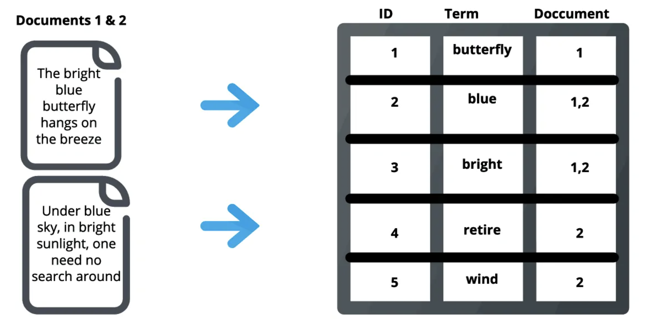
Inverted index basics:
Notes:
https://medium.com/@f2004392/everything-about-elastic-search-basics-9e7eedc24767
https://www.elastic.co/what-is/elasticsearch
https://www.loggly.com/use-cases/log-management-in-microservices-architecture/

Slide 49
Chaotic Approach

Slide 50
Systematic Approach

Slide 51

General Framework
Requirement analysis (Functional, Non Functional)
Defining data models
Estimations -> No. of users, no. of active users, data size, QPS (Read write)
Designing System Interfaces
High Level Design
Detailed Designs
Identifying and Resolving Bottlenecks
Analytics on top of built system

Slide 52
Requirement Analysis:: Generic Questions
Scale of useability
Availability v/s Consistency
Where does customer reside (Where to place datacenter)
How much latency is acceptable
Type of client interfaces
User growth rate -> 5*yearly calc + 0.5 YC
Legal obligation (GDPR)

Slide 53
Requirement Analysis
Generally questions are open ended and vague
Clarifying the scope of the problem
What areas we should be focussing
Example: Design facebook
Which part? Feed/Messenger/Notification/UI/Backend
Feed
Should it contain photos/videos
Should it be searchable?
Do we need to have real time updates
Do we need to support trending/hot topics?

Slide 54
Requirement Analysis:: Gotchas
Problems can be too abstract, try to narrow down as much as possible
Confirm with the interviewer before proceeding
State any assumptions very well

Slide 55

Today’s Design Problem
You are technical architect in a big car company. The company is launching an IOT based health monitoring system for the car. Propose a scalable design for the same.

Slide 56
Requirement Analysis:: Example
You are technical architect in a big car company. The company is launching an IOT based health monitoring system for the car. Propose a scalable design for the same.
What would be the user base? 10M
What is the frequency of event update? 1 min
How to show the data?
How frequent to show the data?
What sensors to account for initially?
How to show this data? Notification v/s pull?
Availability v/s consistency?
Read heavy vs write heavy

Slide 57
General Framework
Requirement analysis
Defining data models
Back of the envelope estimation
Designing System Interfaces
High Level Design
Detailed Designs
Identifying and Resolving Bottlenecks

Slide 58
Data Models
Analyze query pattern
What is the read/write ratio?
Is some part of data queried too frequent ⇒ Caching
Identify major entities of the system
Identify if there is relational aspect to problem
Relational ⇒ Identify PK, FK, indexes, Joins if required
Non Relational ⇒ Identify Partition Key, Sort key
Would we need some kind of storage engine like S3 to store photos/blobs etc

Slide 59
Data Models: SQL v/s NoSql
Strong consistency requirement ⇒ SQL
Familiarity constraints ⇒ SQL
Variable schema ⇒ NoSql
Horizontal data distribution requirement ⇒ NoSql
Event capture and processing ⇒ NoSql

Slide 60
Data Models: Example
Extending the previous questions for data model definition
R/W
Very low
Go for db which are write optimized
UI Can be on minute/ hour/ day basis
Pre computed data on day/hour basis can be cached
vehicleId, attribute, value, timestamp (Pretty basic)
Both models can be used
Better to go with NoSQL?
Huge data volume
Partition by vehicleId
Indexed on timestamp
Hashed or Ranged?
Here attribute can be temperature, available fuel

Slide 61
General Framework
Requirement analysis
Defining data models
Back of the envelope estimation
Designing System Interfaces
High Level Design
Detailed Designs
Identifying and Resolving Bottlenecks

Slide 62
Back of the envelope estimation (Guesstimates)
System Storage
Can be derived from data models
There may be cases of photos/videos
Throughput
Can be derived from concurrent users at any point in system
Can it be skewed?
Network bandwidth
In terms of bytes/sec.
Helps in figuring out the instances needed
Ask about archiving strategy
Hot/Cold Storage
Note: Try to calculate growth of these estimates Try

Slide 63
Back of the envelope estimation (Guesstimates)
System Storage vehicleId(4 bytes), attribute(10 bytes), value (4 bytes), timestamp (8 bytes) (10M Cars, event is per minute)
1 row ⇒ 25 bytes * 10*10^6 ⇒ 25*10^7 ⇒ 0.25 GB/min
0.25GB/min ⇒ 4 MB/s * 86400 (10^5) ⇒ 400 GB/day * 400 ⇒ 160 TB/Year
Throughput (Event)
10*10^6 / min ~ 2*10^5 request / sec
Average machine can handle 5K req/sec (Assumption, 4CPU, 8GB) ⇒ 40 servers needed. The actual numbers can be deduced by performing an extensive load test
Network bandwidth
0.25 GB / min + header info in each request ⇒ 4-5MB/s
Available bandwidth ⇒ 100MB/s/machine (Assumption) ⇒ At Least 1 server are needed
Note: Try to calculate growth of these estimates, handle temporary spikes

Slide 64
General Framework
Requirement analysis
Defining data models
Back of the envelope estimation
Designing System Interfaces
High Level Design
Detailed Designs
Identifying and Resolving Bottlenecks

Slide 65
System Interfaces
Try to Establish exact contract
Ensures that we haven’t missed any requirements
Server Interfaces
API Definition

Slide 66
System Interfaces:: Example
POST /measurement
Body: measurement data
GET /aggregate_data
Query Params: criterias

Slide 67
General Framework
Requirement analysis
Defining data models
Back of the envelope estimation
Designing System Interfaces
High Level Design
Detailed Designs
Identifying and Resolving Bottlenecks

Slide 68
High Level Design
Identify the major components of the system
Draw the components and their interactions
Make sure that HLD fits into a single page

Slide 69
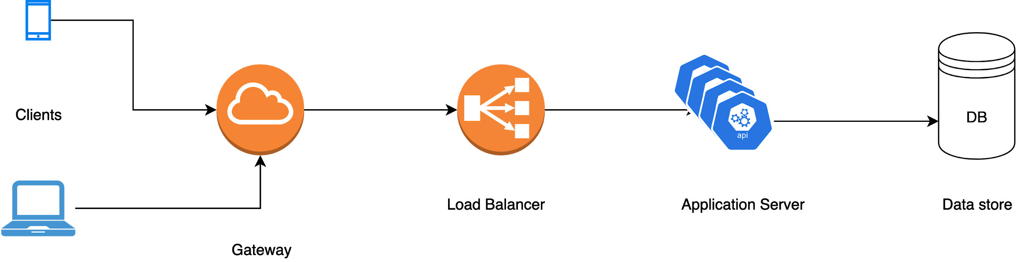
High Level Design:: Example

Slide 70
General Framework
Requirement analysis
Defining data models
Back of the envelope estimation
Designing System Interfaces
High Level Design
Detailed Designs
Identifying and Resolving Bottlenecks

Slide 71
Detailed Design
Generally guided by interviewer or ask interviewer for the same
Delve deep into one or more of the components made
Explain the thought process behind the design decision
Justify decision by explaining pros and cons

Slide 72
Detailed Design:: Example
How will the load balancer work
Which algorithm will you select here
Is the choice of storage layer justified

Slide 73
General Framework
Requirement analysis
Defining data models
Back of the envelope estimation
Designing System Interfaces
High Level Design
Detailed Designs
Identifying and Resolving Bottlenecks
Analytics

Slide 74
Identifying and Resolving Bottlenecks
Figure out Single Point of failures
Components which can’t scale beyond a certain point
Consider aspects like availability, fault tolerance, failure, recovery etc

Slide 75
Identifying and Resolving Bottlenecks:: Example
What will happen if Load balancer fails?
Can the application perform if there are faults at DB layer
How to cope with the situation when there is no network connectivity between client and API Gateway?

Slide 76
General Framework
Requirement analysis
Defining data models
Back of the envelope estimation
Designing System Interfaces
High Level Design
Detailed Designs
Identifying and Resolving Bottlenecks

